Slide 1
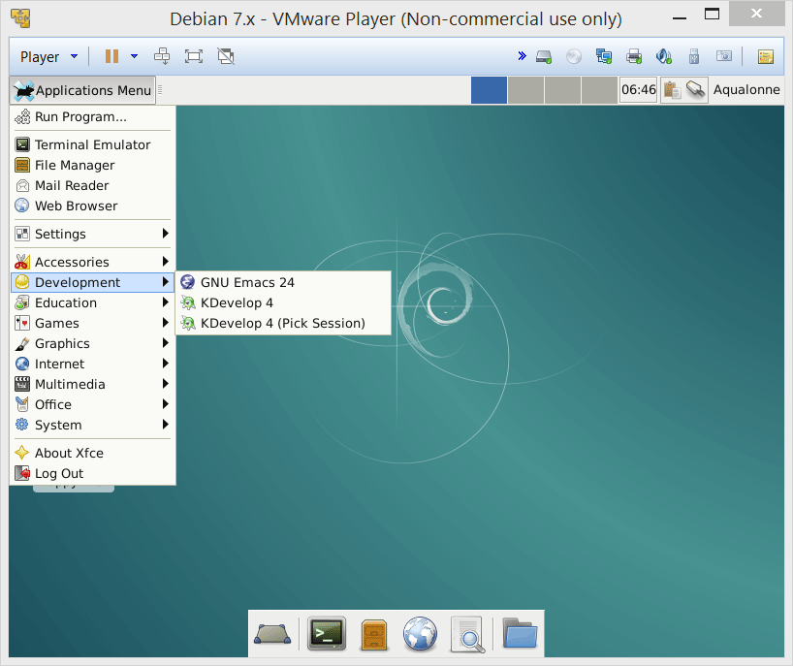
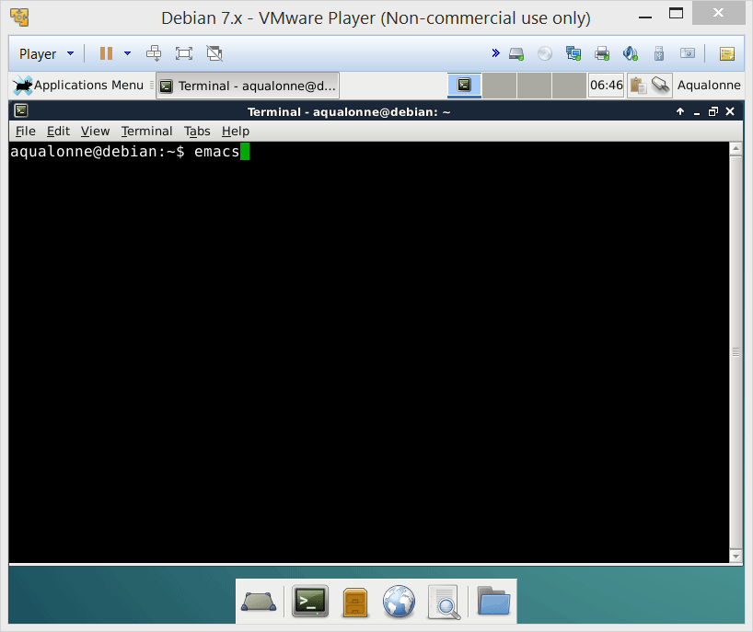
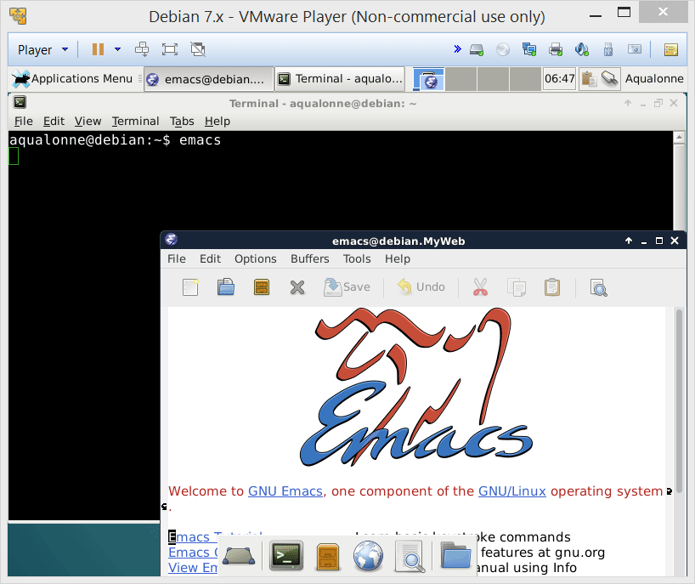
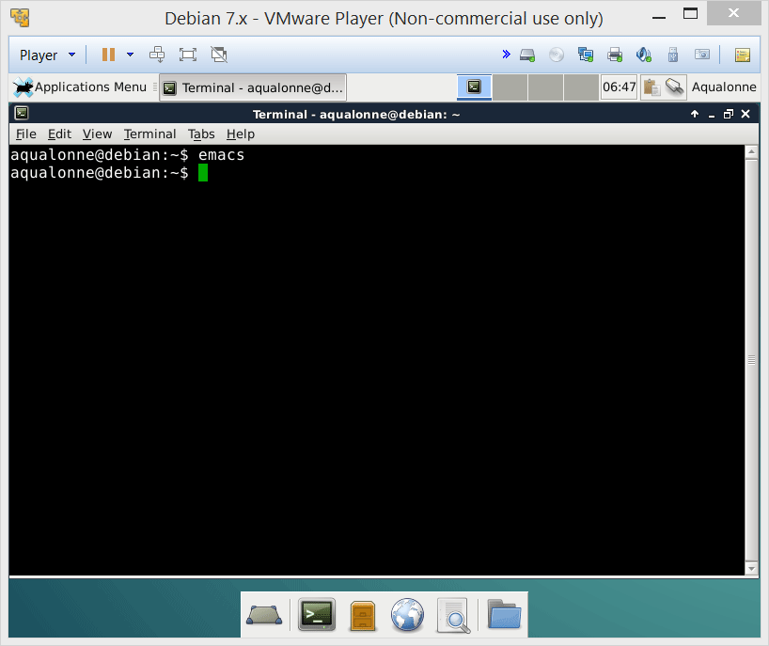

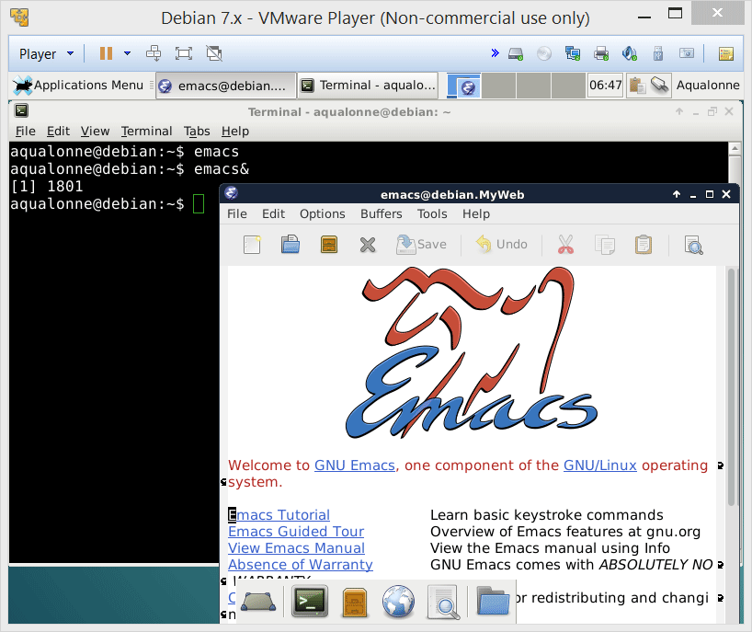
Our editor for this module: emacs
We don’t get the prompt back. Control has now been passed to Emacs, until it ends.
Emacs has a graphical user interface. It cannot reside within the shell. To detach it:
emacs&
& starts a program as an independent task
3
While and for loops

Slide 2
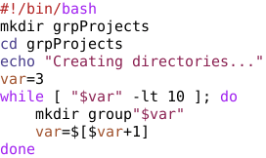

While
Typical uses:
Generating a set of numbers
Modify the template to show the value of all arguments.
1
“$#” ];
echo “${var}”
$# is the number of argument
$1, $2, ..., ${10}, ${11} is an argument
20
While and for loops

Slide 3
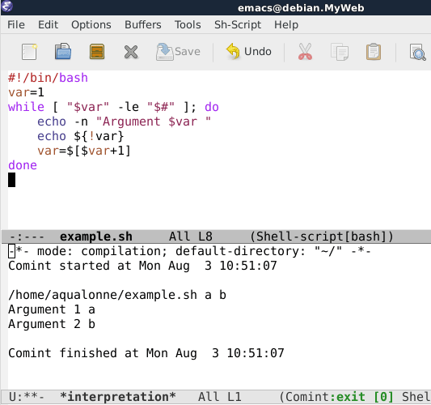

While
Typical uses:
Generating a set of numbers
Modify the template to show the value of all arguments.
Little trick: we don’t want the value of var, but of the argument that it refers to. Using ! performs an indirection.
You can read more about tricks for parameter expansions at:
http://wiki.bash-hackers.org/syntax/pe
21
While and for loops

Slide 4
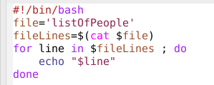
For .. in
Keep doing this for each item in that
30
While and for loops

Slide 5
For .. in
Keep doing this for each item in that
30
While and for loops

Slide 6
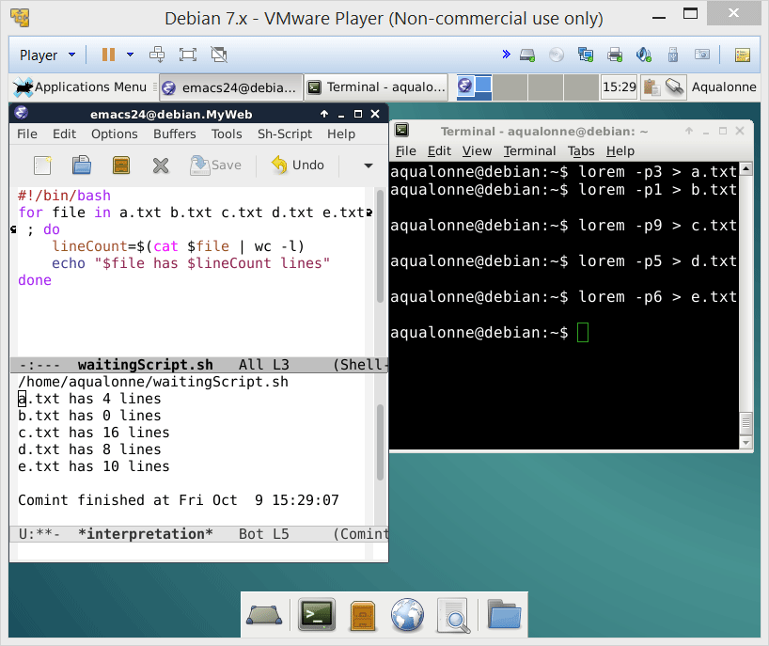
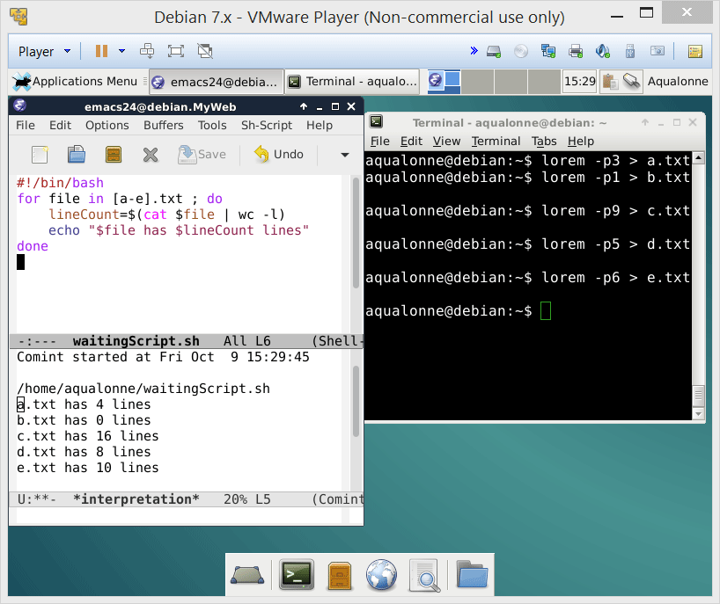
For .. in
Typical uses:
processing a set of files
for ..var.. in ..files.. ; do
32
While and for loops

Slide 7

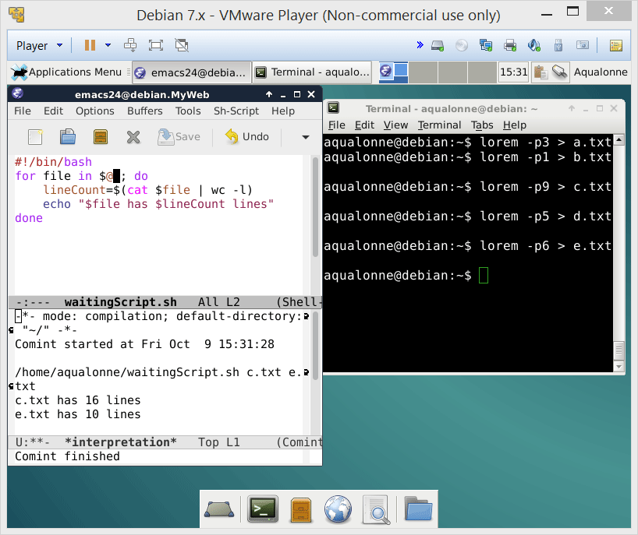
For .. in
Typical uses:
processing a set of files
for ..var.. in ..files.. ; do
processing a set of arguments
Note that if you want to start from e.g. the 2nd argument, you can use ${@:2}
for ..var.. in $@ ; do
...or if you’re feeling lazy, processing arguments is what it does by default:
for ..var.. ; do
33
While and for loops

Slide 8
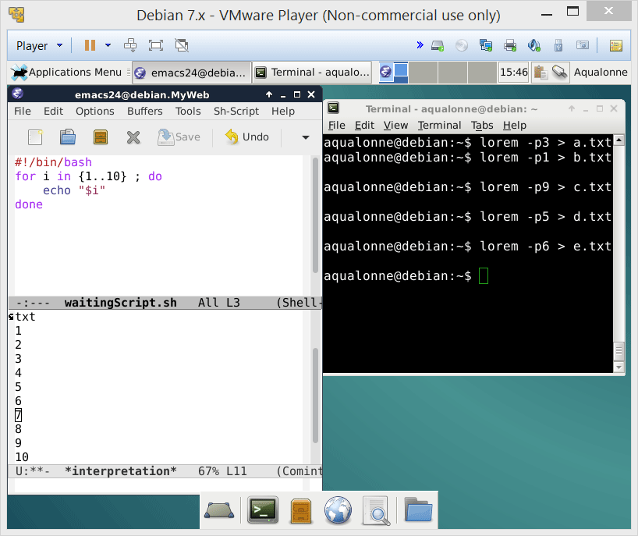
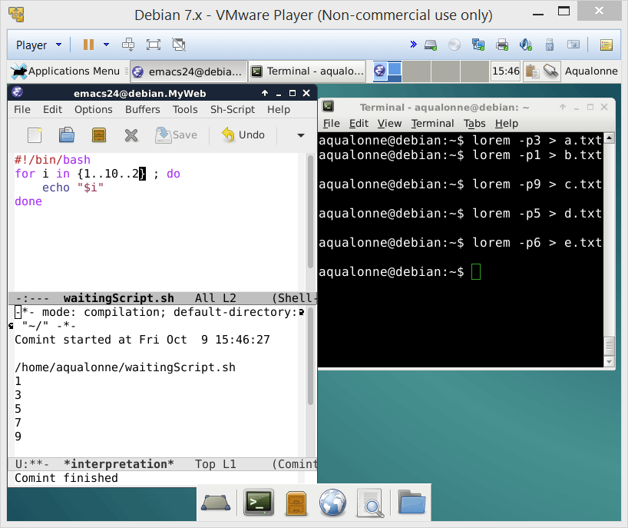
For .. in
Typical uses:
processing a set of files
for ..var.. in ..files.. ; do
processing a set of arguments
increment
start
end
for ..var.. in $@ ; do
generating a set of numbers
for i in {..set..} ; do
34
While and for loops

Slide 9

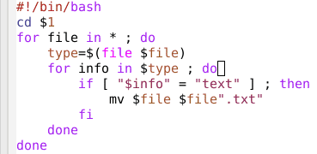
Real-world uses
For each file in the folder
Ask for the type
If the answer includes “text”
Add .txt at the end
43
While and for loops

Slide 10
Real-world uses
For each file in the folder
Ask for the type
If the answer includes “text”
Add .txt at the end
43
While and for loops

Slide 11
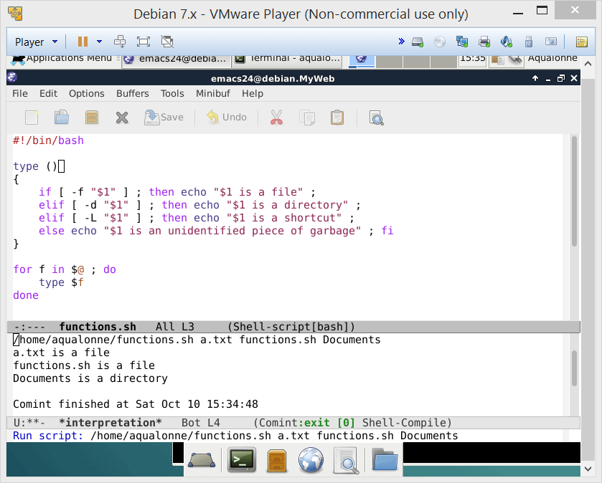
Power up your scripts with functions!
You can pass arguments to a function, and they will be accessed as $1, ...
Note that $0 is always the name of the script! For the function’s name:
${FUNCNAME[0]}
4
Functions

Slide 12
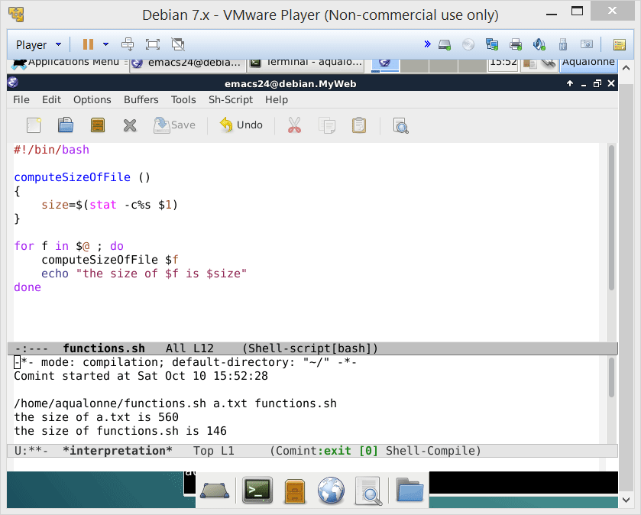

Power up your scripts with functions!
Variables made in a function are accessible in the whole script.
Do not use return to get variables’ values back!
For values
5
Functions

Slide 13
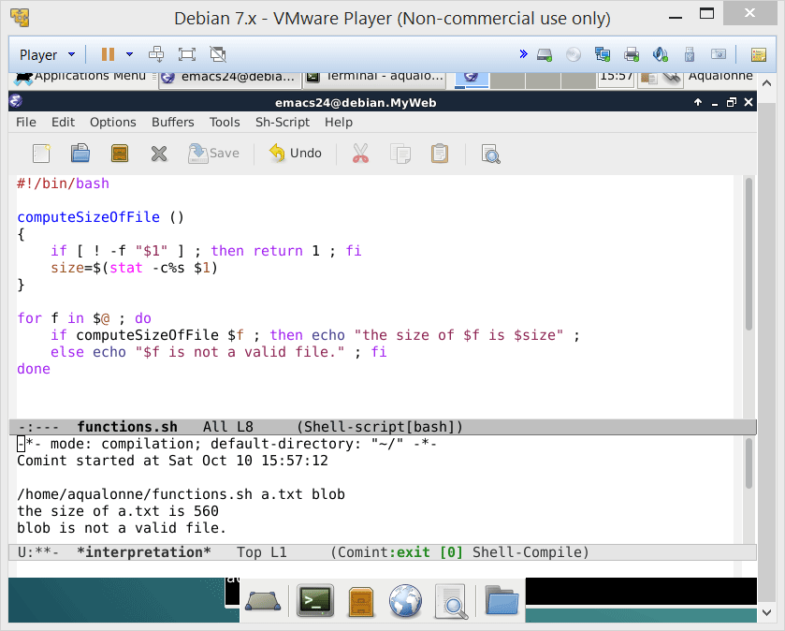
Power up your scripts with functions!
return is used only to end a function and give a status
0 for success
1 for fail
7
Functions

Slide 14
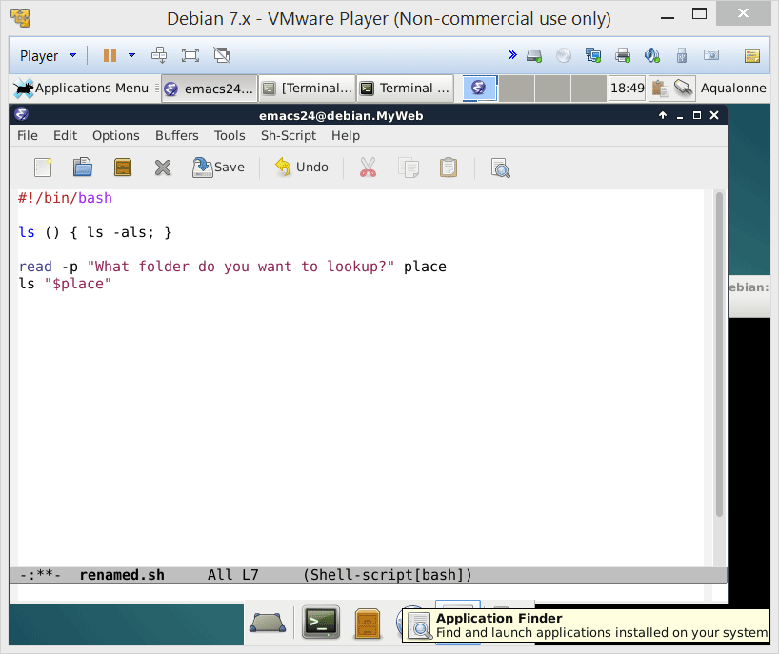
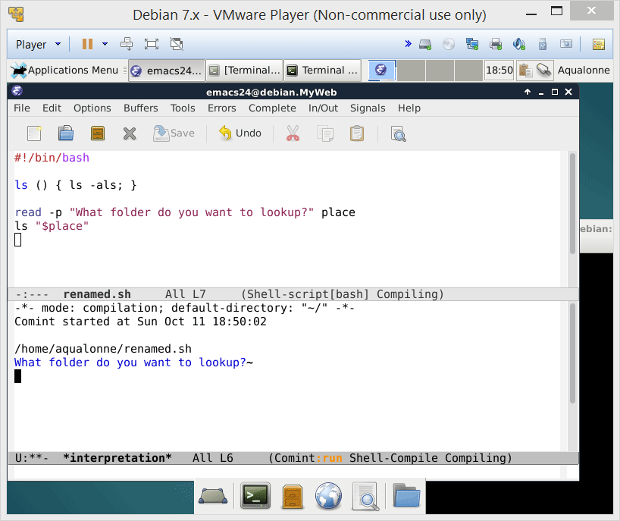
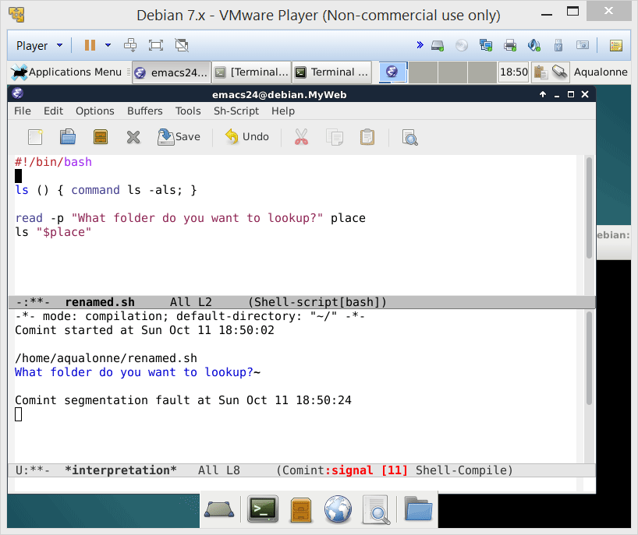
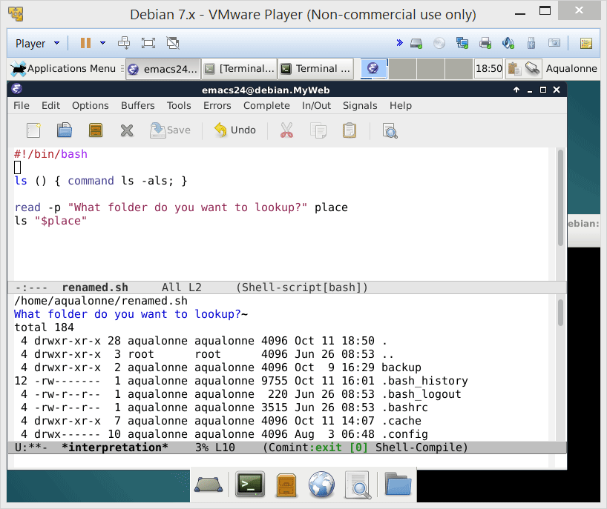

How some people use functions…
If you want to overload a command, then you need to use the command keyword
3 hours later...
23
Functions

Slide 15
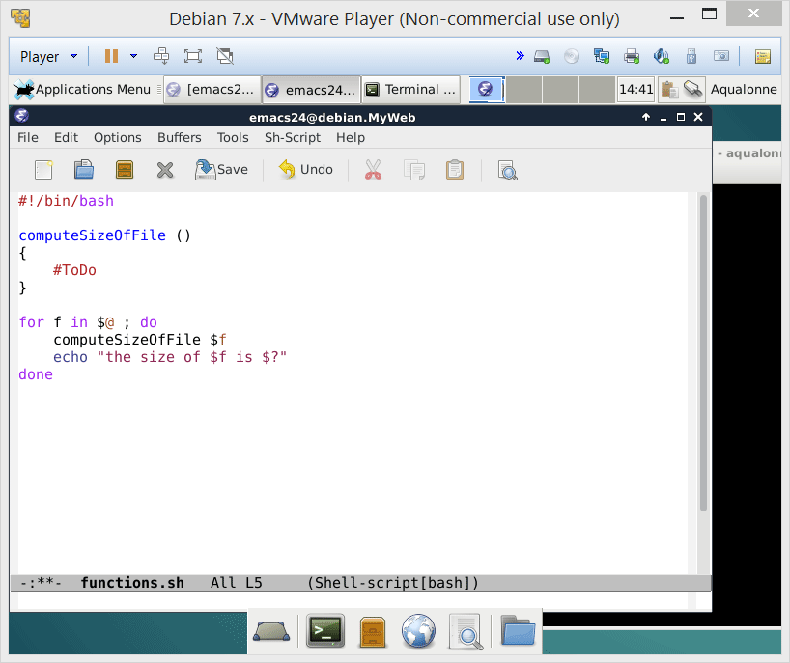
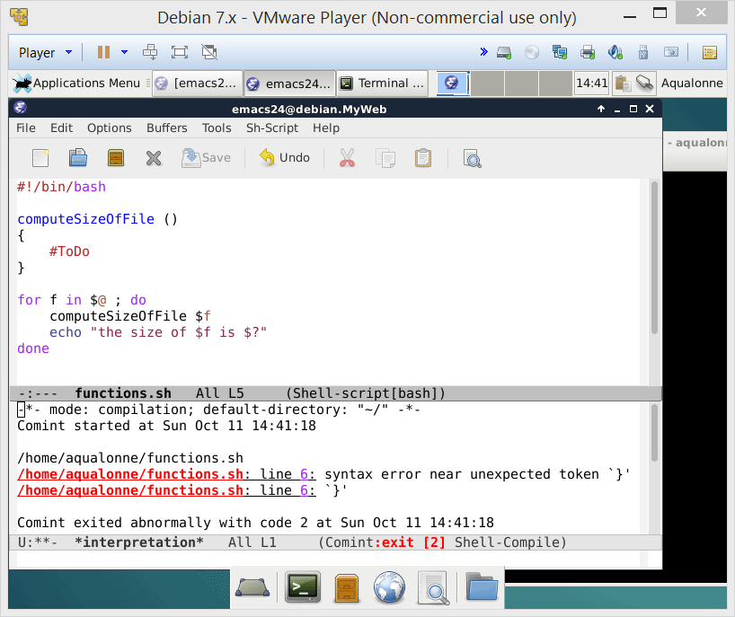
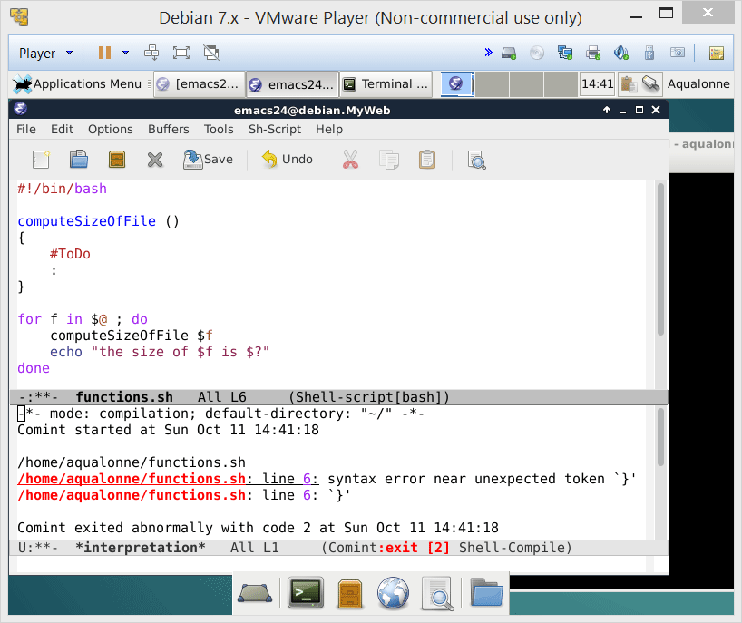

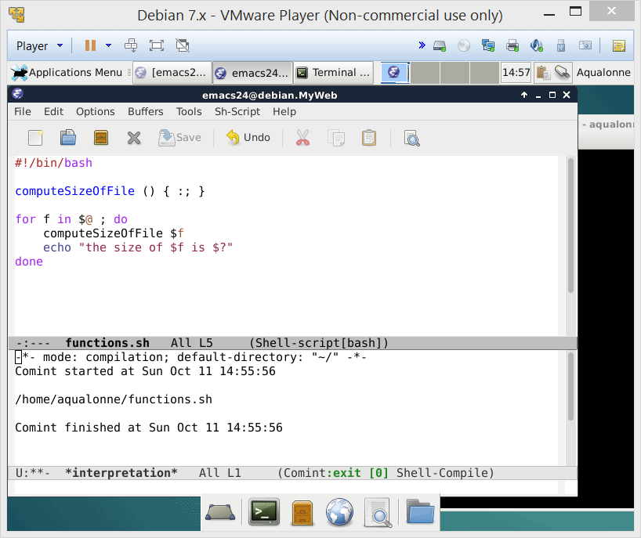
How some people use functions…
A function must contain at least one instruction.
: is the do-nothing instruction
If a function is a one liner, commands must be ; separated with a final ;
24
Functions

Slide 16
How some people use functions…
This is a valid function... It will run!
:(){ :|: & };:
25
Functions

